Slide 1
ER-to-Table

Slide 2
MAPPING ER DIAGRAMS TO RELATIONAL DATA MODEL
Conceptual ER-models allow you to more accurately represent the subject area than logical models (relational, network, etc.).
But, there are no DBMSs that support ER models i.e. Need to convert ER diagrams to an implementation schema.
So, ER diagram is converted into the tables in Relational Data Model (RDM or RM).
The ER to RDM mapping method is based on the formation of a set of initial relation tables from ER-diagrams (initial logical model) and based on the factors:
atomic and multivalued of attribute,
cardinality (max=one-many) and
obligation (min=optional-mandatory) of relationship.

Slide 3
ER to RDM MAPPING BRIEFLY
A table is created for each entity:
Each simple entity attribute corresponds to a current table column, derived entity attribute removed from a current table.
Each element of composite attribute corresponds to a current table column.
Each multivalued attribute +1 separate table will require.
For Binary Relationship With Weak Entity Set:
2 tables for 2 entities will be required.
For a relationship without cardinality ratios description:
3 tables will be required.
For a relationship of cardinality type many-to-many (m:n) relationships between two entity sets:
3 tables will be required (two tables for entity sets and one for relationship)

Slide 4
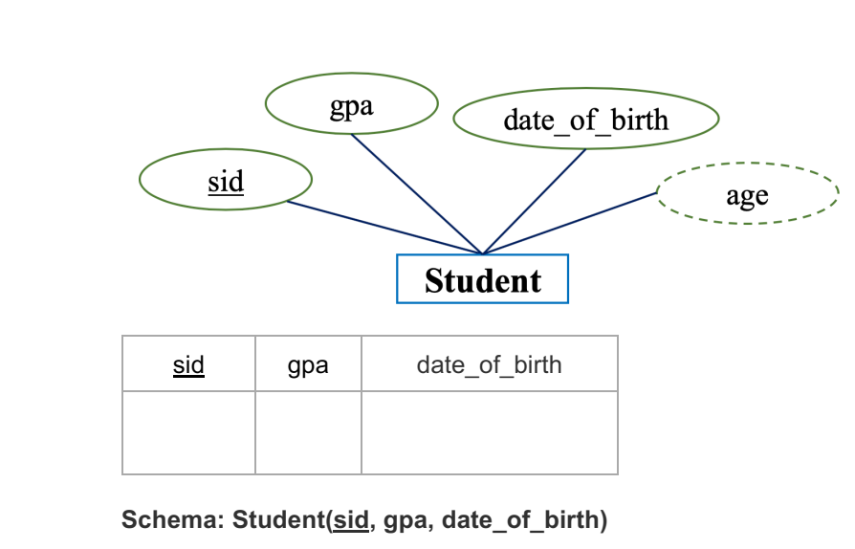
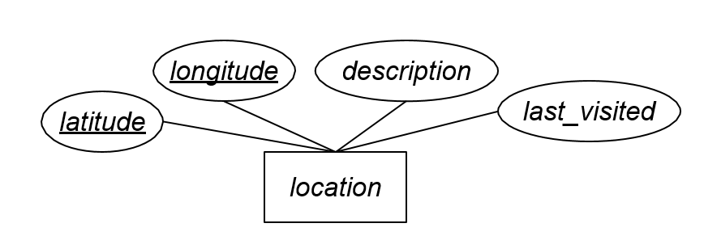
ER to Table For Strong Entity Set With Only Simple Attributes
A strong entity set with only simple attributes will require only 1 table in relational model.
Attributes of the table will be the attributes of the entity set.
Derived attributes removed from the table.
The primary key of the table will be the key attribute of the entity set.
location(latitude, longitude, description, last_visited)

Slide 5
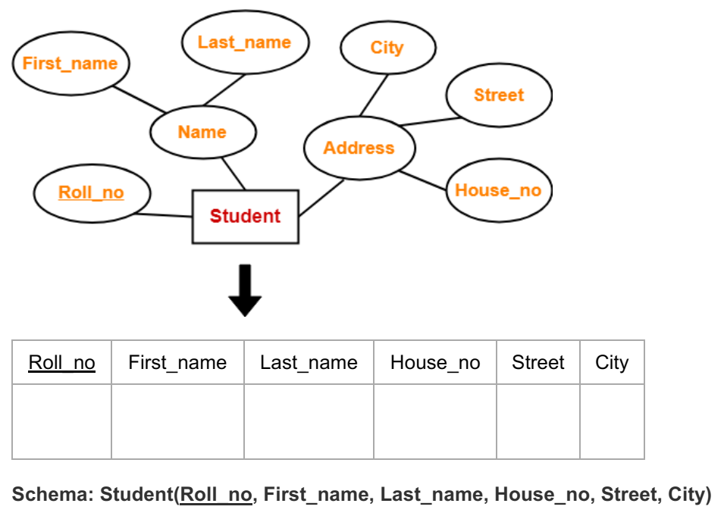
ER to Table: For Strong Entity Set With Composite Attributes
A strong entity set with any number of composite attributes will require only 1 table in relational model.
While conversion, simple attributes of the composite attributes are taken into account and not the composite attribute itself.

Slide 6
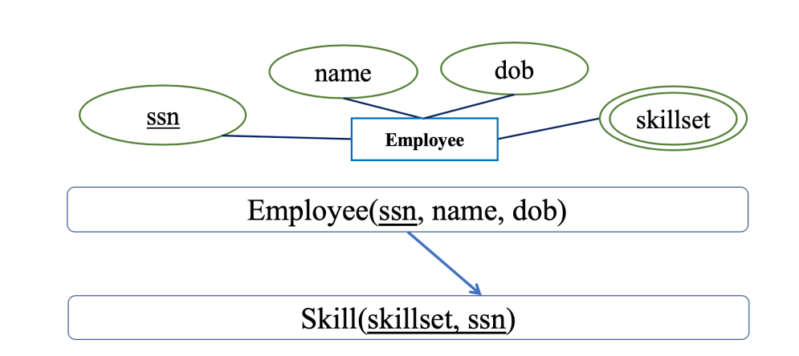
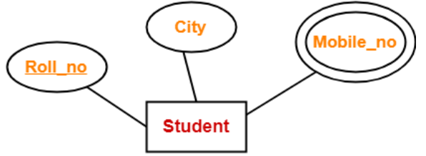
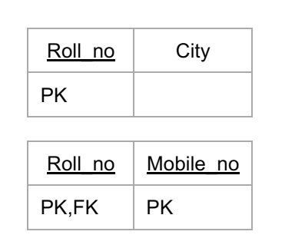
ER to Table: For Strong Entity Set With Multivalued Attributes
A strong entity set with any number of multivalued attributes will require 2 tables in relational model.
One table will contain all the simple attributes with the primary key.
Other table will contain the primary key and all the multivalued attributes
Student(Roll_no, City)
Students_Mobile(Roll_No, Mobile_No)

Slide 7
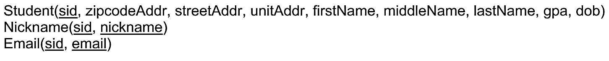
Question: Build A Relational Schema From The Following ER Diagram
Solution

Slide 8
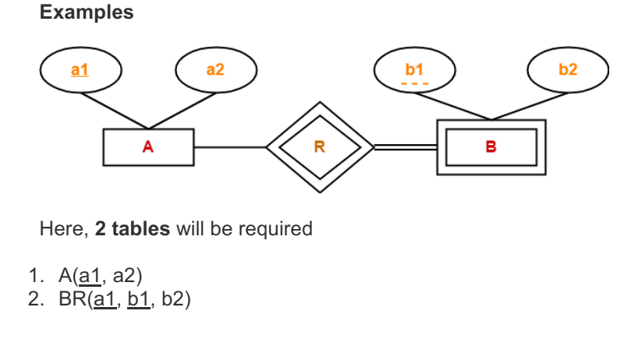
ER to Table: For Binary Relationship With Weak Entity Set
Weak entity set always appears in association with identifying relationship with total participation constraint.

Slide 9
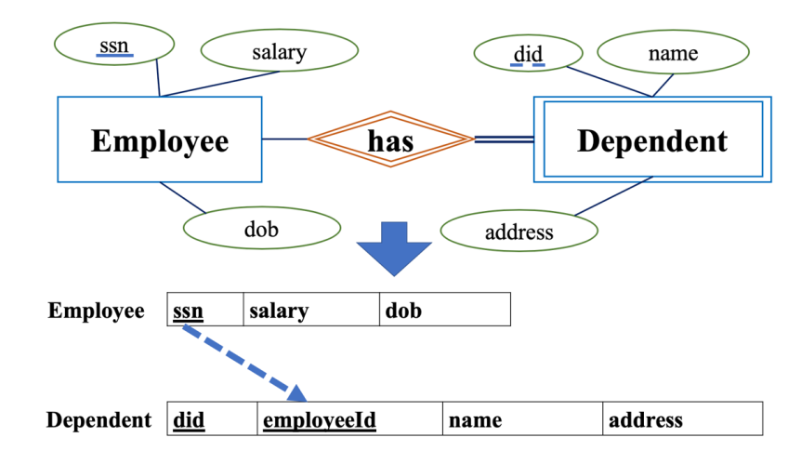
ER to Table: For Binary Relationship With Weak Entity Set

Slide 10
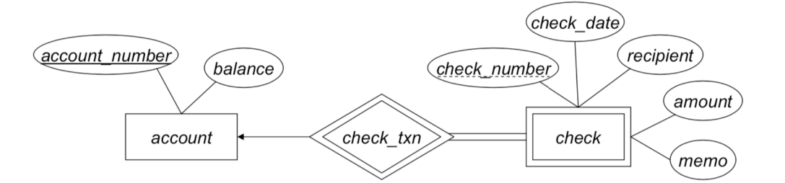
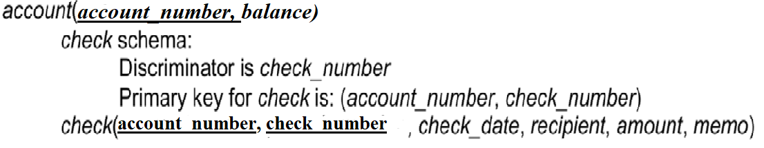
Question: Build the Relational Schema From The Following ER Diagram
Solution

Slide 11
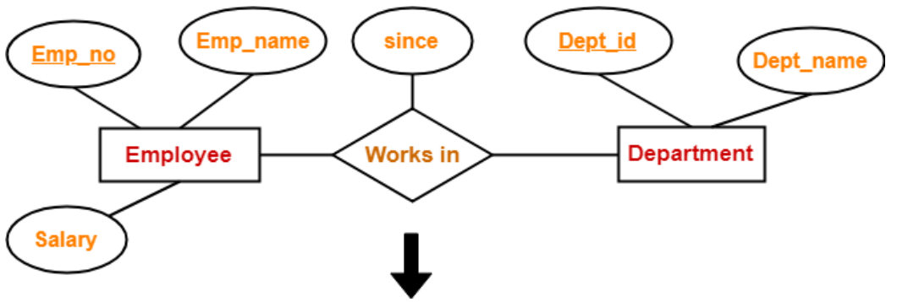
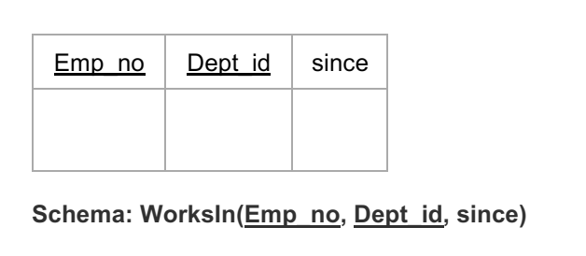
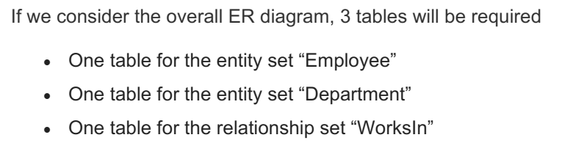
ER to Table: Translating Relationship Set Without Cardinality Ratios Description Into A Table
A relationship between 2 relations will require 3 tables in the relational model.
It will be treated as many-to-many relationship.
Separate tables will be created for entity sets and relationships.
Attributes of the relationship table are:
Primary key attributes of the participating entity sets (also become composite primary key in this table). • Its own attributes if any.

Slide 12
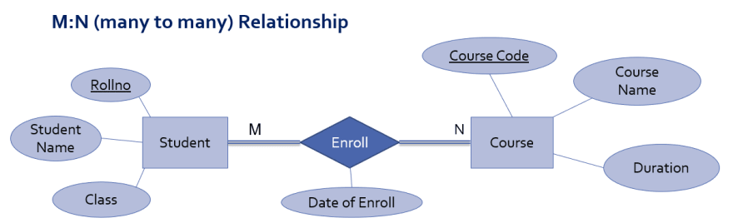
ER to Table: For Binary Relationship With Cardinality Ratio M:N
Consider same relationship set enrolled exist between entity sets student and course, which means multiple students can enroll in multiple courses
To convert this Relationship set into relational schema:
Relationship set is mapped as separate relation
Key attributes of participating entity sets are mapped as primary key for that relation
Attribute of relationship set becomes simple attributes for that relation
And separate relation is created for other participating entities

Slide 13
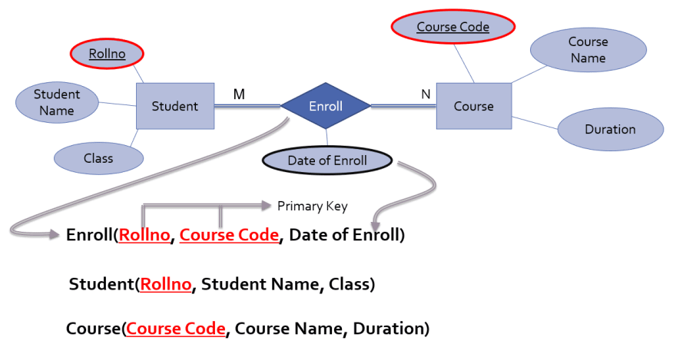
ER to Table: For Binary Relationship With Cardinality Ratio M:N
Consider same relationship set enrolled exist between entity sets student and course, which means multiple students can enroll in multiple courses

Slide 14
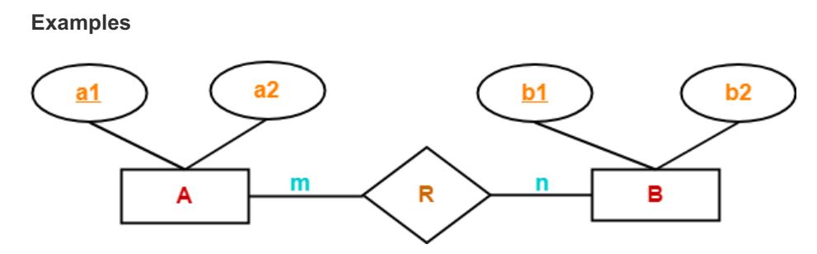
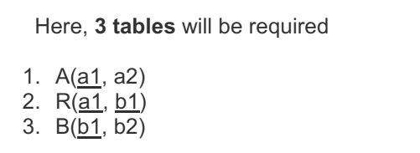
ER to Table: For Binary Relationship With Cardinality Ratio M:N

Slide 15
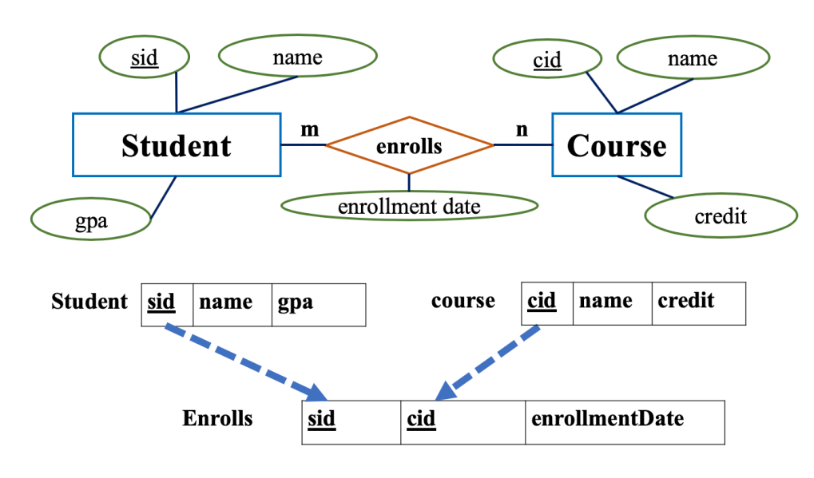
ER to Table: For Binary Relationship With Cardinality Ratio M:N

Slide 16
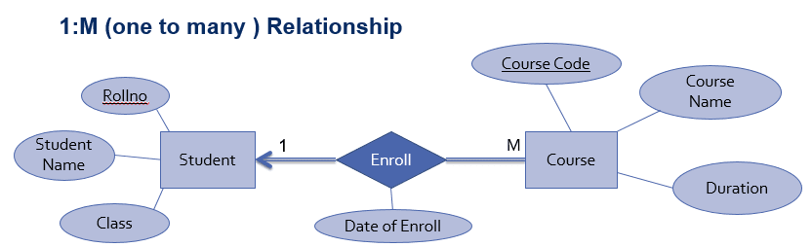
ER to Table: For Binary Relationships With Cardinality Ratio 1:M
Consider 1:M relationship set enrolled exist between entity sets student and course as follow,
Here Enroll is 1:M relationship exist between entity set student and course which means that one student can enroll in multiple courses. In this case, to convert this relationship into relational schema:
Separate relation is created for all participating entity sets (student and course)
Key attribute of one’s side entity set (Student) is mapped as foreign key in many’s side relation (Course).
All attributes of relationship set are mapped as attributes for relation of one’s side entity set (student)

Slide 17
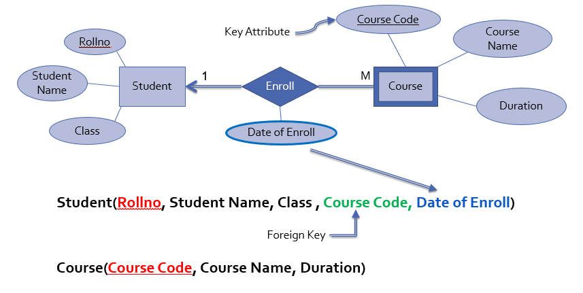

ER to Table: For Binary Relationships With Cardinality Ratio 1:M
Consider 1:M relationship set enrolled exist between entity sets student and course as follow,
Course(Course_Code, Course_Name, Duration, RollNo, Date_of_Enrollment)
Student(RollNo, Student_Name, Class)

Slide 18
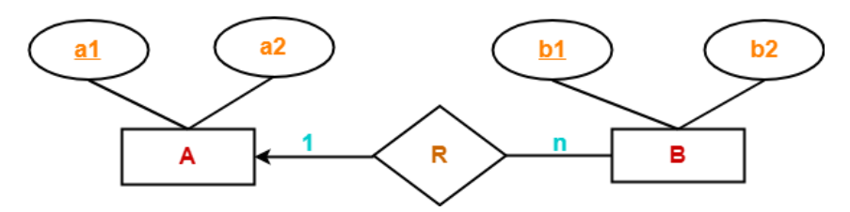
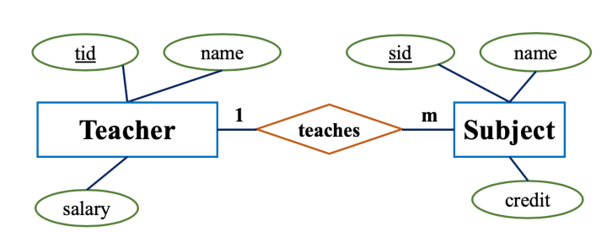
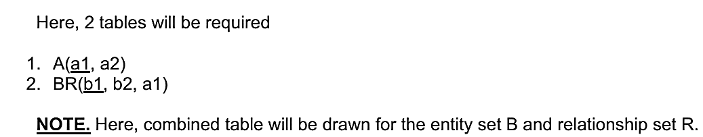
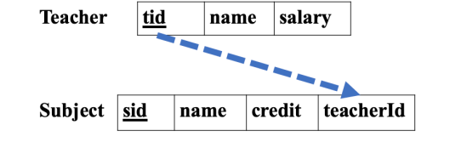
ER to Table: For Binary Relationships With Cardinality Ratio 1:M
Question: Convert the following Schema to Relations:

Slide 19
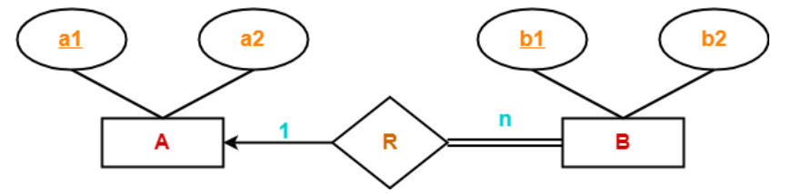
ER to Table: For Binary Relationships With Cardinality Ratio 1:M with Total Participation Constraints
Foreign Key with NOT NULL constraints will be applied.
A(a1, a2)
B(b1, b2, a1)
a1 as NOT NULL.

Slide 20
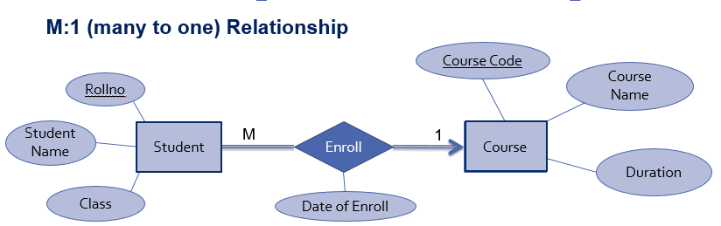
ER to Table: For Binary Relationships With Cardinality Ratio M:1
Consider same relationship set enroll exist between entity sets student and course. But here student is many side entities set while course is one side entity set. Which means many students can enroll in one course.
To convert this relationship set into relational schema: 1. Separate relation is created for all participating entity sets. 2. Key attribute of one’s side entity set (Course) is mapped as foreign key in Many’s side relation (Student) 3. All attributes of relationship set are mapped as attributes for one’s side relation course.

Slide 21
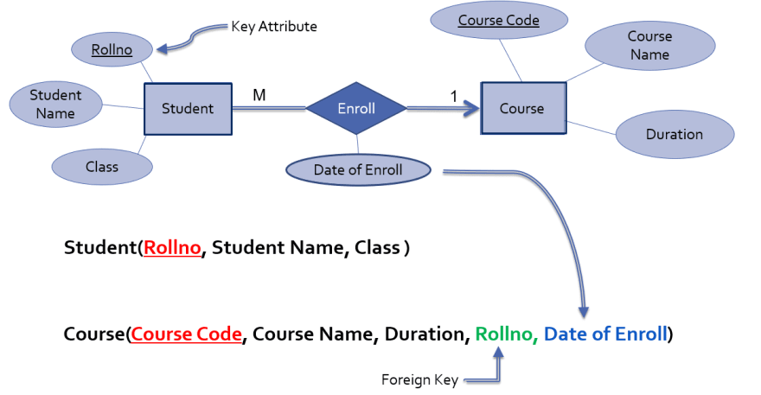
ER to Table: For Binary Relationships With Cardinality Ratio M:1
Student(RollNo, Student_Name, Class, Course_Code, Date_of_Enrollment)
Course(Course_Code, Course_Name, Duration)

Slide 22
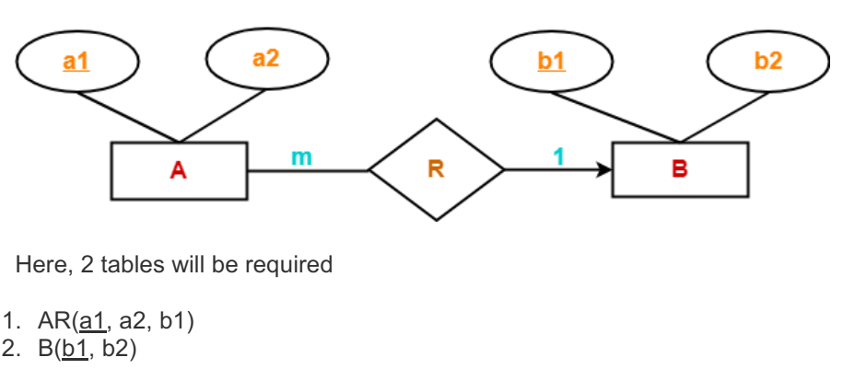
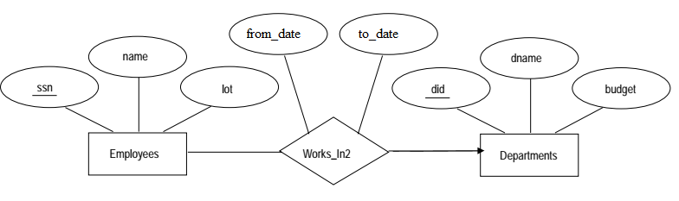
ER to Table: For Binary Relationships With Cardinality Ratio M:1
Question: Convert the following Schema to Relations:
Employees(ssn, name, lot, did, from_date, to_date)
Departments(did, dname, budget)

Slide 23
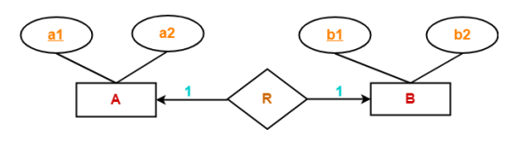
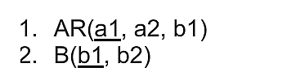
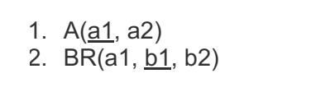
ER to Table: For Binary Relationships With Cardinality Ratio 1:1
Case 1: Binary Relationship with 1:1 cardinality and partial participation of both entities
Here, 2 tables will be required. Either combine ‘R’ with ‘A’ or ‘B’ including FK as UNIQUE.
OR

Slide 24
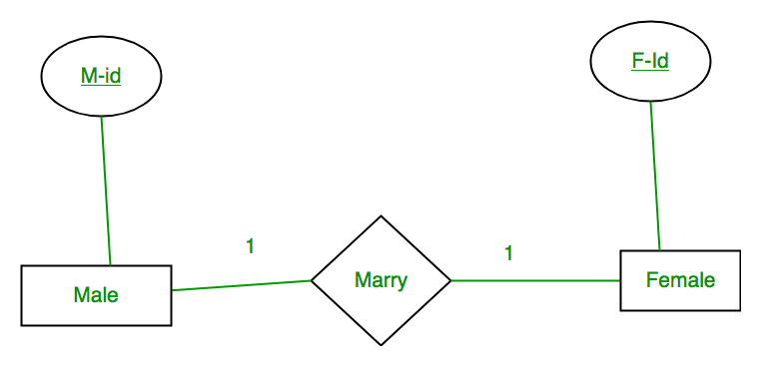
ER to Table: For Binary Relationships With Cardinality Ratio 1:1
Case 1: Binary Relationship with 1:1 cardinality and partial participation of both entities
Example: A male marries 0 or 1 female and vice versa as well. So, it is 1:1 cardinality with partial participation constraint from both.
Binary relationship with 1:1 cardinality will have 2 table if partial participation of both entities in the relationship.
Here, we can use PK of one table as FK in another table including FK as UNIQUE.
Male(M_ID, Other attributes, F_ID)
Female(F_ID, other attributes)
(OR)
Male(M_ID, Other attributes)
Female(F_ID, other attributes, M_ID)

Slide 25
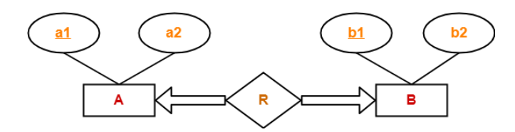
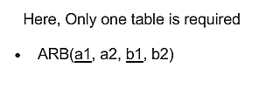
ER to Table: For Binary Relationships With Cardinality Ratio 1:1
Case 2: Binary Relationship with 1:1 cardinality and total participation of both entities
If there is total participation for both entity sets in a binary relationship with cardinality 1:1 then the binary relationship is represented using only single table including UNIQUE and NOT NULL Constraints

Slide 26
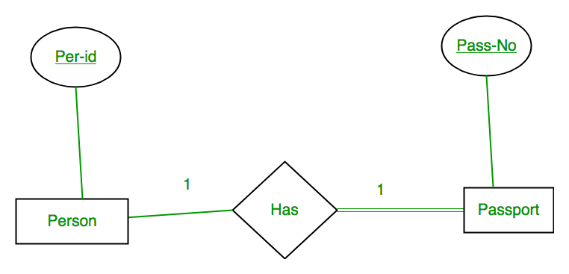
ER to Table: For Binary Relationships With Cardinality Ratio 1:1
Case 3: Binary Relationship with 1:1 cardinality with total participation of an entity set.
Example: A person has 0 or 1 passport number and Passport is always owned by 1 person. So it is 1:1 cardinality with full participation constraint from Passport.
Person(Per_ID, Other Person Attributes, Pass_No, Other Passport Attributes, Pass_No should be Unique.)

Slide 27
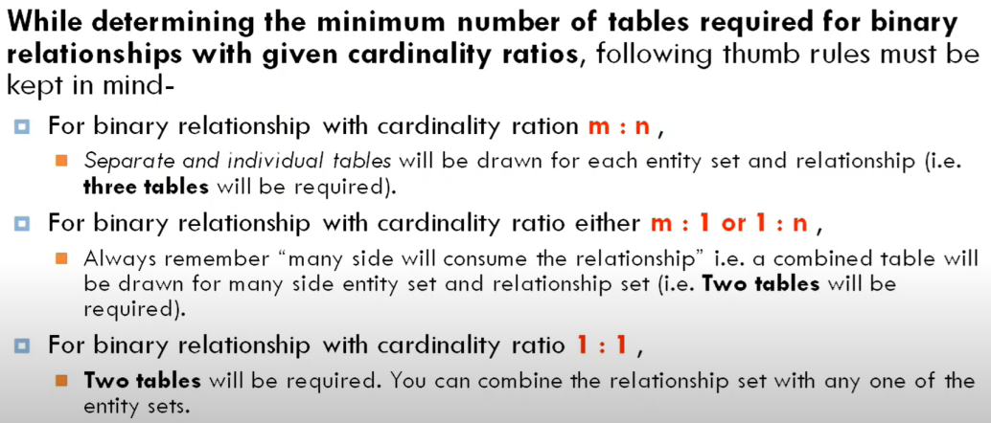

Slide 28
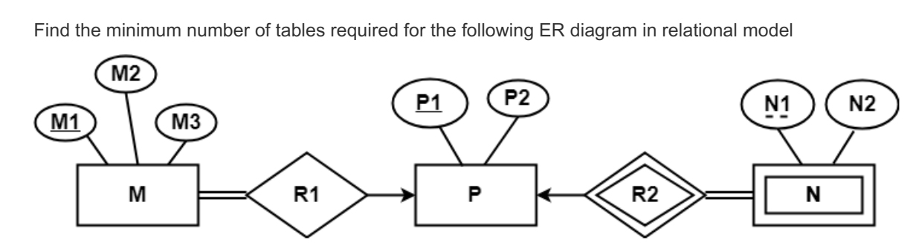
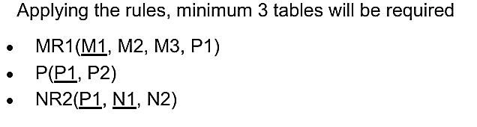
Practice Problem Based On Converting ER Diagram To Tables
PROBLEM-01:
SOLUTION:

Slide 29
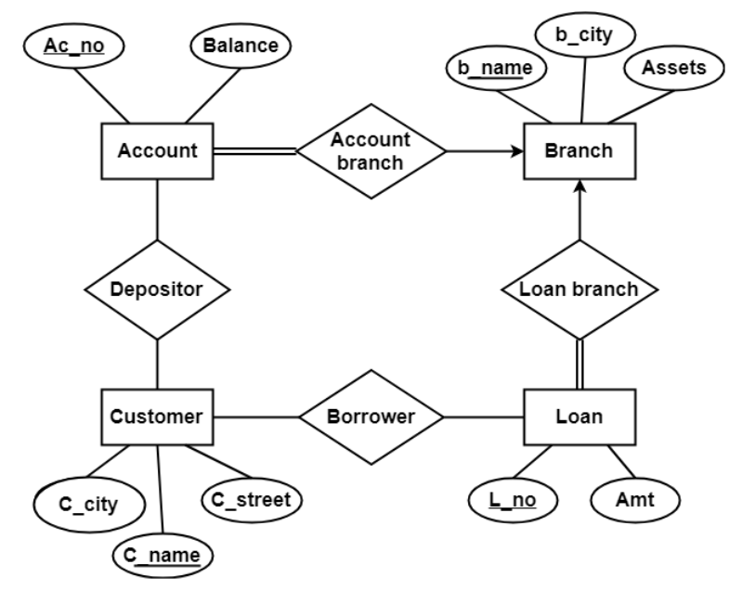
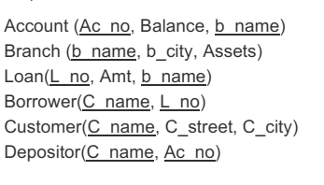
Practice Problem Based On Converting ER Diagram To Tables
PROBLEM-02: Find the minimum number of tables required to represent the given ER diagram in relational model
SOLUTION

Slide 30
Thank You

